Slide 1

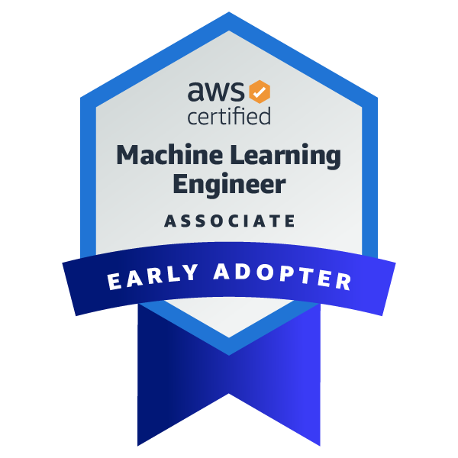
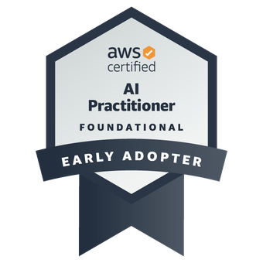
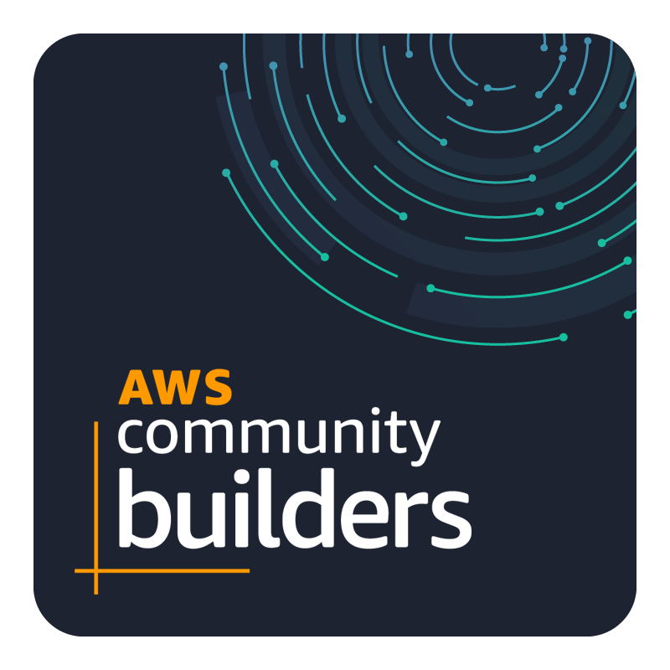
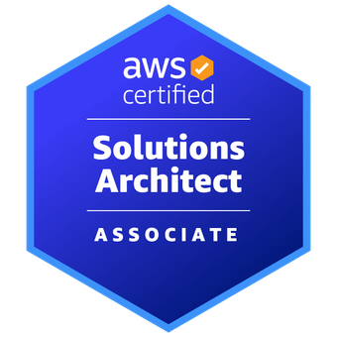

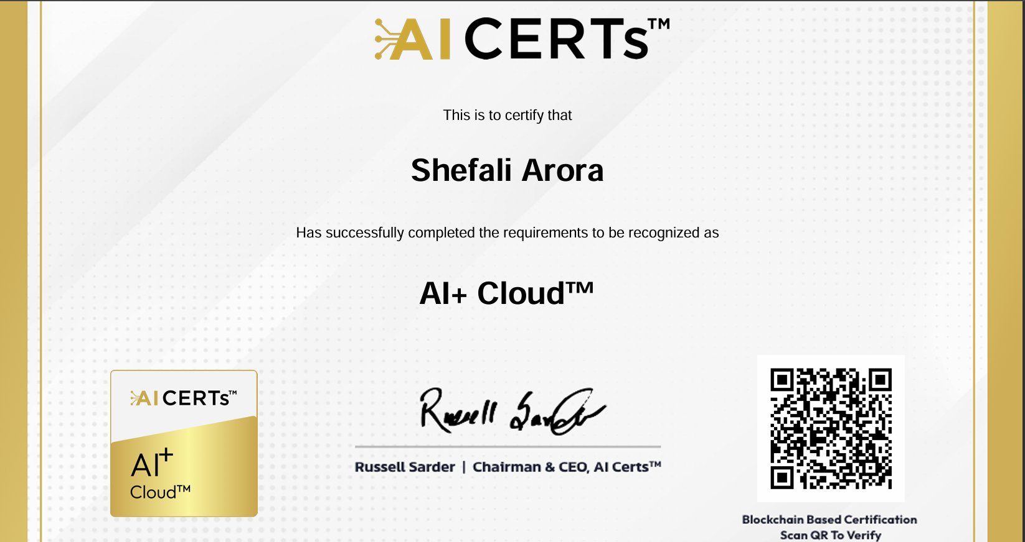
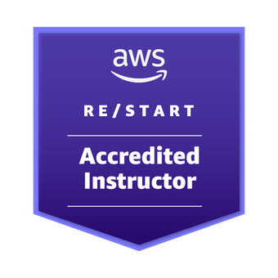

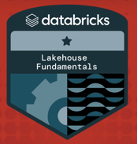
About the Speakers
Career Milestones : Total Experience: 16 years ​
AWS Train The Trainer​
Ex-AWS Authorized Instructor
AI+ Cloud Certified​
AWS Solutions Architect Associate
My Career Journey featured , AWS
Community Day Nov 2022, India​
Ass. Professor in Engg. College
Shefali Arora (her)
Director Rashiv Cloud Solutions
Clientele list :
Amazon Web Services across the globe
ICICI Lombard, Mumbai
Kentucky State University​
TechTalent Academy, UK​
Cognixio Client , USA​
Netcom Learning , UK​
Orbit Venture, Indonesia​

Slide 2
Module 1: Introduction to the AWS Cloud

Slide 3
Overview – Topics to be Covered
What is the cloud?
Cloud vs on-premises
Benefits of the AWS Cloud
Interact with AWS Management Console
AWS Global Infrastructure
Terminology and concepts related to AWS products and services

Slide 4

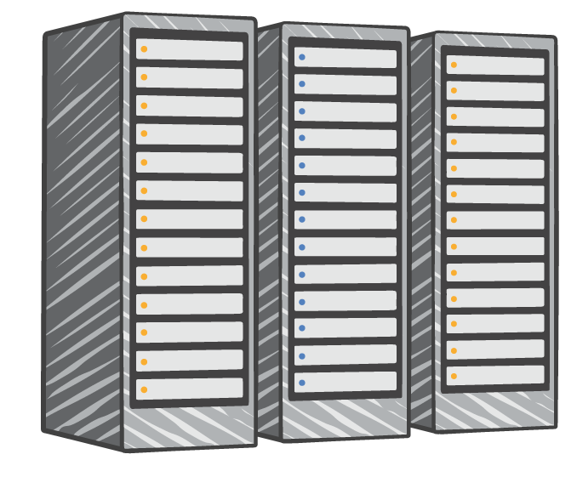



What is the cloud?
On premises
Internet
Servers
Storage
Databases
Applications
Cloud services provider
Servers Storage
Databases Applications
Corp network
Internet
Notes:
In a traditional on-premises IT environment, all the physical components required to run business systems were owned, operated, maintained, and housed by the company. A user would connect and log on to the corporate network to access resources. This would include things like corporate applications, file sharing, and storage.
The cloud provides access to the same or similar resources through the internet, hosted by a cloud services platform. The term “cloud” comes from a time when internet resources or connectivity were often represented by a cloud in diagrams that illustrated connectivity and data flow.

Slide 5
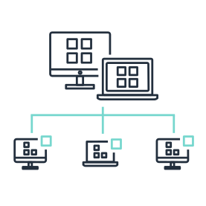

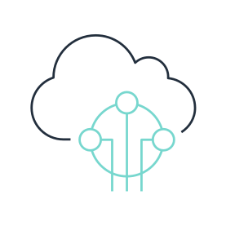
What is cloud computing?
Access services
on-demand
Provision computing resources as needed
Pay only for what you use
Notes:
Cloud computing is an on-demand delivery of IT resources over the internet, usually with pay-as-you-go pricing.
Instead of buying, owning, and maintaining physical data centers and servers, you can access technology services, such as computing power, storage, and databases, on an as-needed bases from a cloud provider such as Amazon Web Services (AWS).

Slide 6
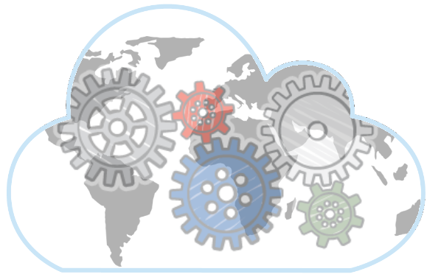







How does it work?
AWS owns and maintains the network-connected hardware
You provision and use what you need
Storage
Database
Business Applications
Compute
Networking & Content Delivery
Internet of Things
Notes:
Cloud computing provides a simple way to access servers, storage, databases, and a broad set of application services over the internet. A cloud services platform such as Amazon Web Services (AWS) owns and maintains the network-connected hardware (like servers) that you need to run these application services, while you provision resources such as virtual servers called instances and manage them through a web application.

Slide 7
Cloud Computing Models
Software as a Service (SaaS)
Platform as a Service (PaaS)
Infrastructure as a Service (IaaS)
Notes:
Cloud computing models
There are three main models for cloud computing. Each model represents a different part of the cloud computing stack.
Infrastructure as a Service (IaaS):
IaaS contains the basic building blocks for cloud IT and typically provides access to networking features, computers (virtual or on dedicated hardware), and data storage space. IaaS provides you with significant flexibility and management control over your IT resources and is similar to the existing resources in many IT departments.
Platform as a Service (PaaS):
PaaS eliminates the need for organizations to manage the underlying infrastructure (usually hardware and operating systems) and allows you to focus on deploying and managing your applications. This helps you be more efficient because you don’t need to worry about resource procurement, capacity planning, software maintenance, patching, or any of the other undifferentiated heavy lifting involved in running your application.
Software as a Service (SaaS):
SaaS offers you a complete product that is run and managed by the service provider. In most cases, people referring to SaaS are referring to end-user applications. With a SaaS offering, you don’t have to think about how the service is maintained or how the underlying infrastructure is managed; you only need to think about how you will use that particular piece of software. A common example of a SaaS application is web-based email, which allows you to send and receive email without having to manage the servers or the operating system the email runs on. You don’t have to patch the mail servers or handle feature additions to it.

Slide 8

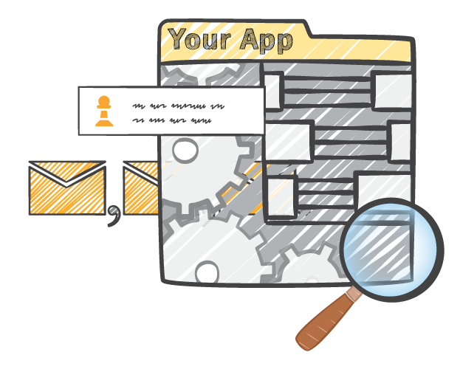
Cloud Deployment Models
On premises
Hybrid
Cloud
Notes:
On premises/private:
Deployment of on-premises resources using virtualization and resource management tools is sometimes called a “private cloud.” On-premises deployment lacks many of the benefits of cloud computing, but is sometimes preferred for its ability to provide dedicated resources. This is like using legacy IT infrastructure with new technologies (such as virtualization and application management) to try to mimic a true cloud environment.
Hybrid:
A hybrid deployment connects infrastructure and applications between cloud-based resources and on-premises resources. Organizations use this to extend their infrastructure into the cloud while connecting cloud resources to internal systems. For more information on hybrid deployment, see https://aws.amazon.com/enterprise/hybrid/.
Cloud:
A cloud-based application is fully deployed in the cloud, and all parts of the application run in the cloud. Applications in the cloud have either been created in the cloud or have been migrated from an existing infrastructure to take advantage of the benefits of cloud computing. Cloud-based applications can be built on low-level infrastructure pieces (as we discussed previously with IaaS) or can use higher-level services (such as SaaS) that provide abstraction from the management, architecting, and scaling requirements of core infrastructure.

Slide 9

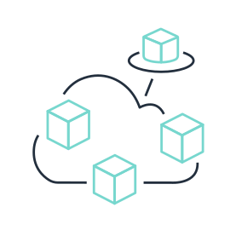


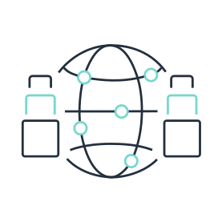
What are the benefits of the AWS Cloud?
Pay as you go
Benefit from massive economies of scale
Stop guessing capacity
Increase speed and agility
Realize cost savings
Go global in minutes
Notes:
Six key benefits of cloud computing are:
Pay as you go: You pay for computing resources that you consume instead of investing heavily in data centers and servers before you know how you will use them.
Benefit from massive economies of scale: Customers pay lower prices as AWS achieves higher economies of scale due to the aggregated use of the large number of AWS customers.
Stop guessing capacity: With cloud computing, you no longer have to guess your infrastructure capacity needs. You can access as much or as little capacity as you need, and scale up and down as required with only a few minutes notice.
Increase speed and agility: IT resources are only a click away, which means that you reduce the time to make those resources available to your developers from weeks to minutes, which leads to increased agility for your organization.
Realize cost savings: With cloud computing, you can focus on your customers by offering improved products and services instead of maintaining physical data centers.
Go global in minutes: You can deploy your application in multiple Regions around the world with a few clicks. This means that you can provide lower latency and a better experience for your customers at a minimal cost.

Slide 10
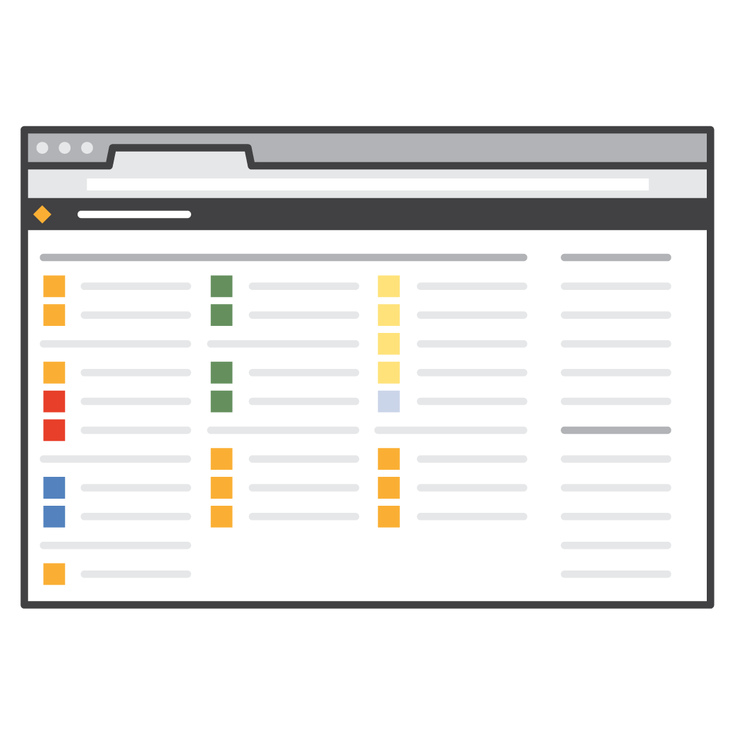
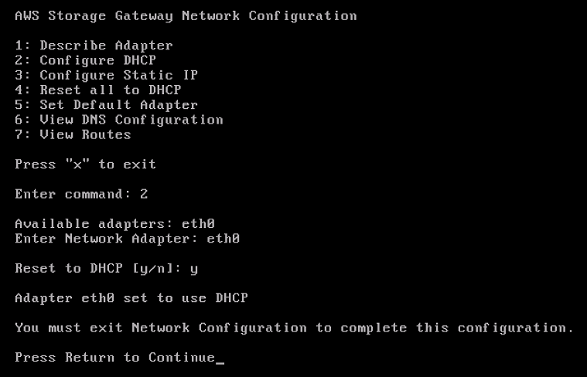
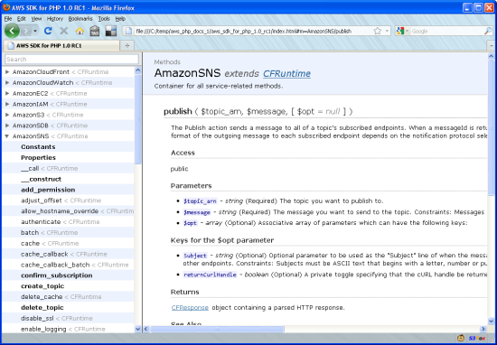
Three ways to interact with AWS
AWS Management Console
Easy-to-use graphical interface
Command Line Interface (AWS CLI)
Access to services by discrete command
Software Development Kits (SDKs)
Access services in your code

Slide 11
AWS Global Infrastructure
Regions
Edge locations
Availability Zones
AWS Global Infrastructure

Slide 12
Hands-on Activity: Explore global region maps, AZs, and service availability
https://aws.amazon.com/about-aws/global-infrastructure/

Slide 13
Regions
Each Region:
Is completely independent
36 Launched Regions
Uses AWS network infrastructure
Has two or more Availability Zones
Src: https://aws.amazon.com/about-aws/global-infrastructure
Notes:
Each AWS Region consists of multiple, isolated, and physically separate Availability Zones within a geographic area. This achieves the greatest possible fault tolerance and stability. In your account, you determine which Regions you need.
When you view your resources, you see only the resources that are tied to the Region that you specify in the console. This is because Regions are isolated from each other and AWS doesn’t automatically replicate resources across Regions.
You can run applications and workloads from a Region to reduce latency to end users. You can do this while avoiding the upfront expenses, long-term commitments, and scaling challenges associated with maintaining and operating a global infrastructure.
For more information about AWS Regions, see https://aws.amazon.com/about-aws/global-infrastructure/regions_az/.

Slide 14

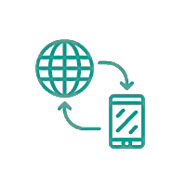
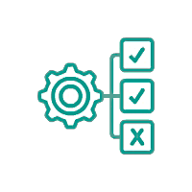

Factors impacting Region selection
Governance
Latency
Service availability
Cost
Notes:
Choosing the right Region is important. You must determine the right Region for your services, applications, and data, based on the following factors:
Governance and legal requirements – Consider any legal requirements based on data governance, sovereignty, or privacy laws.
Latency – Close proximity to customers means better performance.
Service availability – Not all AWS services are available in all Regions.
Cost – Different Regions have different costs. Research the pricing for the services you plan to use and compare costs to make the best decision for your workloads.

Slide 15
Regions point to remember
Each AWS Region consists of multiple, isolated, and physically separate Availability Zones within a geographic area.
This achieves the greatest possible fault tolerance and stability.
In your account, you determine which Regions you need.
When you view your resources, you see only the resources that are tied to the Region that you specify in the console.
This is because Regions are isolated from each other and AWS doesn’t automatically replicate resources across Regions.
You can run applications and workloads from a Region to reduce latency to end users.
You can do this while avoiding the upfront expenses, long-term commitments, and scaling challenges associated with maintaining and operating a global infrastructure.

Slide 16

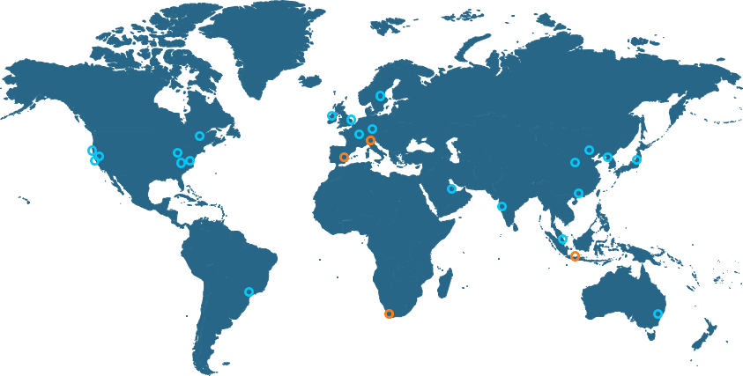
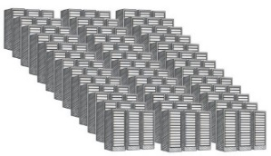
Availability Zones (AZ)
AZ
Availability Zones are:
Data centers in a Region
Designed for fault isolation
Interconnected using high-speed private links
Used to achieve high availability
AZ
AZ
Availability Zone (AZ)
Data center
Data center
Data center
Notes:
A group of two or more data centers is called an Availability Zone.
Availability Zones are multiple, isolated areas within a particular geographic location. When you launch an instance, you can select an Availability Zone or let AWS choose one for you. If you distribute your instances across multiple Availability Zones and one instance fails, you can design your application so that an instance in another Availability Zone can handle requests.
To review Availability Zone information, see https://aws.amazon.com/about-aws/global-infrastructure/.

Slide 17
Availability Zones point to remember
An Availability Zone (AZ) is one or more discrete data centers with redundant power, networking, and connectivity in an AWS Region.
Availability Zones are multiple, isolated areas within a particular geographic location.
When you launch an instance, you can select an Availability Zone or let AWS choose one for you.
If you distribute your instances across multiple Availability Zones and one instance fails, you can design your application so that an instance in another Availability Zone can handle requests.

Slide 18
Edge locations
Edge locations:
Run in major cities around the world
Support AWS services like Route 53 and CloudFront
Src: https://aws.amazon.com/about-aws/global-infrastructure
Notes:
An edge location is the nearest point to a requester of an AWS service. Edge locations are located in major cities around the world. They receive requests and cache copies of your content for faster delivery.
To deliver content to end users with lower latency, you use a global network of edge locations that support AWS services. CloudFront delivers customer content through a worldwide network of point of presence (PoP) locations, which consists of edge locations and regional edge cache servers.
Regional edge caches, used by default with CloudFront, are used when you have content that is not accessed frequently enough to remain in an edge location. Regional edge caches absorb this content and provide an alternative to that content having to be retrieved from the origin server.
For more information, see https://aws.amazon.com/cloudfront/features/.

Slide 19
Edge location use case
You use edge locations to serve content closer to your customers.
This diagram shows an example of a video file stored in Amazon S3 in South America.
The video file is served faster to a customer in Asia.
The file is cached to an edge location near the customer.
Src: https://aws.amazon.com/about-aws/global-infrastructure
Notes:
You use edge locations to serve content closer to your customers. This diagram shows an example of a video file stored in Amazon S3 in South America. The video file is served faster to a customer in Asia. The file is cached to an edge location near the customer.

Slide 20
High Availability using Multiple Availability Zones
What Is High Availability?
High availability (HA) is about ensuring that your application's downtime is minimized as much as possible, without the need for human intervention.
Levels of Availability:
 | Percent of Uptime | Max Downtime per Year | Equivalent Downtime per Day
1 Nine | 90% | 36.5 days | 2.4 hrs
2 Nines | 99% | 3.65 days | 14 min
3 Nines | 99.9% | 8.76 hrs | 86 sec
4 Nines | 99.99% | 52.6 min | 8.6 sec
5 Nines | 99.999% | 5.25 min | .86 sec

Slide 21


High Availability using Multi AZs
Another web instance In another Availability Zone
RDS Multi-AZ
AWS customers focused on high availability can design their applications to run in multiple AZs to achieve even greater fault-tolerance.
User
Amazon Route 53
Elastic Load Balancing
EC2 Instance
EC2 Instance
RDS DB instance Active (Multi-AZ)
RDS DB Instance Standby (Multi-AZ)
Availability Zone
Availability Zone

Slide 22
High Availability using Multi AZs
Customers who care about the availability and performance of their applications want to deploy these applications across multiple AZs in the same region for fault tolerance and low latency.
AZs are connected to each other with fast, private fiber-optic networking, enabling you to easily architect applications that automatically fail-over between AZs without interruption.

Slide 23
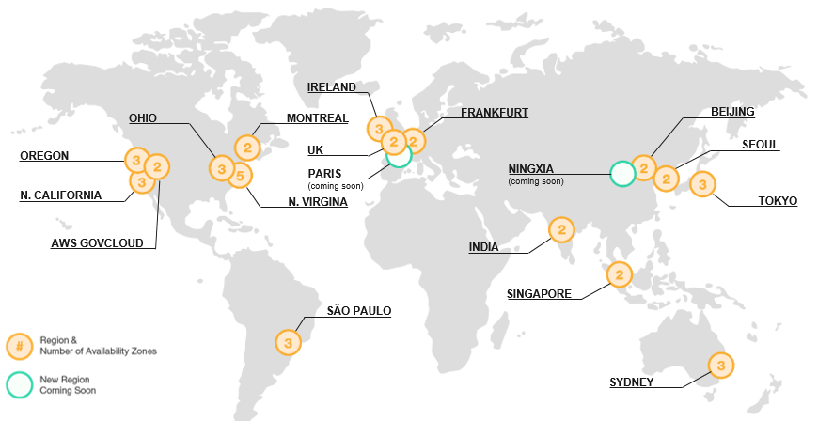
High Availability And AWS Regions
Multi-region deployment increases:
Availability
Cost
Complexity
Default to a single region, unless multi-region deployment is necessary.
If you use a single region, multi-AZ is the bare minimum HA solution.
Src: https://aws.amazon.com/about-aws/global-infrastructure

Slide 24
Knowledge check
What are the four main factors to consider when choosing a Region?
Latency, price, service availability, and compliance
Latency, high availability, taxes, and compliance
Latency, taxes, speed, and compliance
Latency, security, high availability, and resiliency

Slide 25
Knowledge check
What are the four main factors to consider when choosing a Region?
Latency, price, service availability, and compliance (correct)
Latency, high availability, taxes, and compliance
Latency, taxes, speed, and compliance
Latency, security, high availability, and resiliency

Slide 26
Knowledge check
Which of the following accurately describes the relationship among Regions, Availability Zones, and data centers?
Availability Zones consist of one or more Regions. Regions are clusters of data centers.
Data centers are clusters of Availability Zones. Regions are clusters of Availability Zones.
Regions are clusters of Availability Zones. Availability Zones consist of one or more data centers.
Data centers are clusters of Regions. Regions are clusters of Availability Zones.

Slide 27
Knowledge check
Which of the following accurately describes the relationship among Regions, Availability Zones, and data centers?
Availability Zones consist of one or more Regions. Regions are clusters of data centers.
Data centers are clusters of Availability Zones. Regions are clusters of Availability Zones.
Regions are clusters of Availability Zones. Availability Zones consist of one or more data centers. (correct)
Data centers are clusters of Regions. Regions are clusters of Availability Zones.

Slide 28
Knowledge check
Which of the following is a benefit of cloud computing?
Run and maintain your own data centers
Increase time to market
Overprovision for scale
Go global in minutes

Slide 29
Knowledge check
Which of the following is a benefit of cloud computing?
Run and maintain your own data centers
Increase time to market
Overprovision for scale
Go global in minutes (correct)

Slide 30
Key Take Aways
With a pay-as-you-go pricing, cloud services platform AWS delivers:
Compute power
Storage
Database services
Other resources
Regions and Availability Zones are more highly available, fault tolerant, and scalable than traditional datacenter infrastructures.
AWS supports three different management interfaces to access your account:
Web-based AWS Management Console (mobile app as well)
CLI
SDKs

Slide 31
Q&A

Slide 32
Acknowledgement
This presentation has been prepared by summarizing the content taken from different lecture notes, presentations, books and websites available on the web. It is really hard to recall from where these slides exactly come from. However, I don’t want to miss the opportunity to thank individual contributors who created such a good piece of work. Without their contribution, this presentation even can’t be imagined.
This presentation is solely used for education purpose. Still, if you have copyright on any material and want to get it removed from this presentation, please let us know, we will remove it immediately.

Slide 33
THANKS

